Slide 1


Social Buzz
Data Analysis top 5 categories

Slide 2


Today's agenda
Project recap
Problem
The Analytics team
Process
Insights
Summary

Slide 3

Social Buzz, a Social media & content creation platform, has commissioned us to develop a Project in order to help them with the rapid growth they are experiencing.
Project Recap
They expected our help with these three main Ponts:
An audit of their big data practice
Recommendations for a successful IPO
An analysis of their content categories that highlights the top 5 categories with the largest aggregate popularity

Slide 4

Problem
-Over 100000 posts per day
-36,500,000 pieces of content per year
-Issue regarding the most popular content in the platform.
Analysis of the data provided to find Social Buzz’s most popular categories.

Slide 5


Andrew Flemming
– Chief Technical Arquitect
The Analytics team
Marcus Rompton
– Senior Principal
Agostina Altina
– Data Analyst

Slide 6
Data Understanding
Analyse and become familiar with the dataset and the goals.
Process
1
2
Data Cleaning
Clean and Transform the data.
3
Data Modelling
Merge the datasets.
4
Data Analysis
Find most popular categories
5
Insights
Results and a Visualization.

Slide 7

Insights

Slide 8
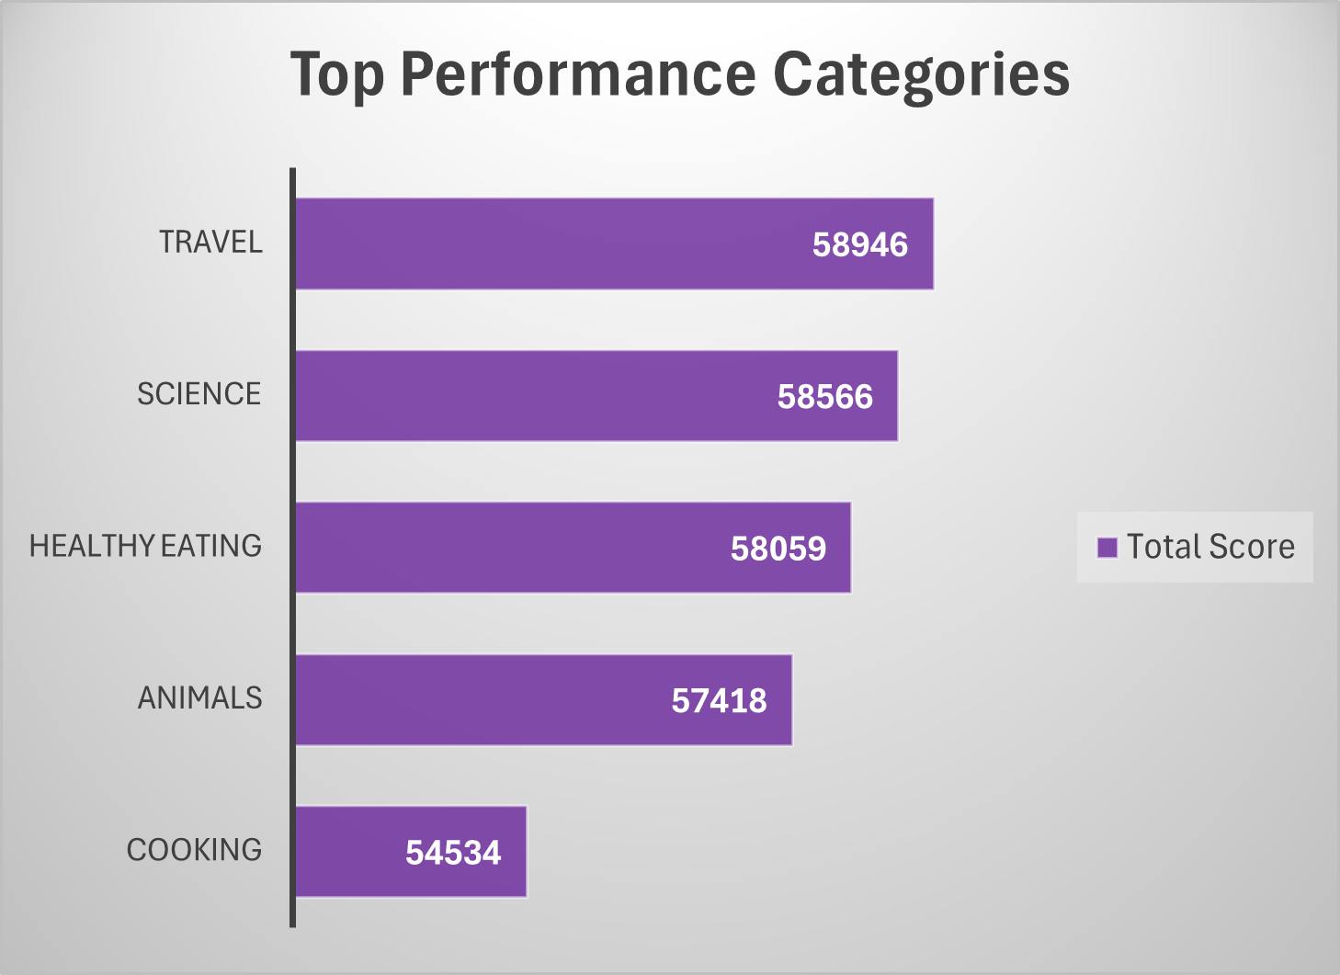
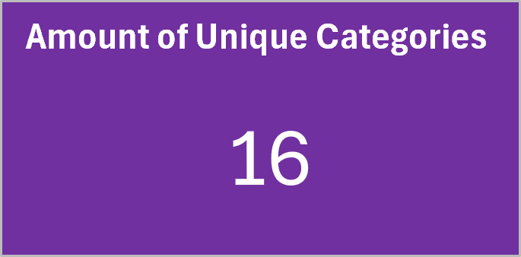

Slide 9
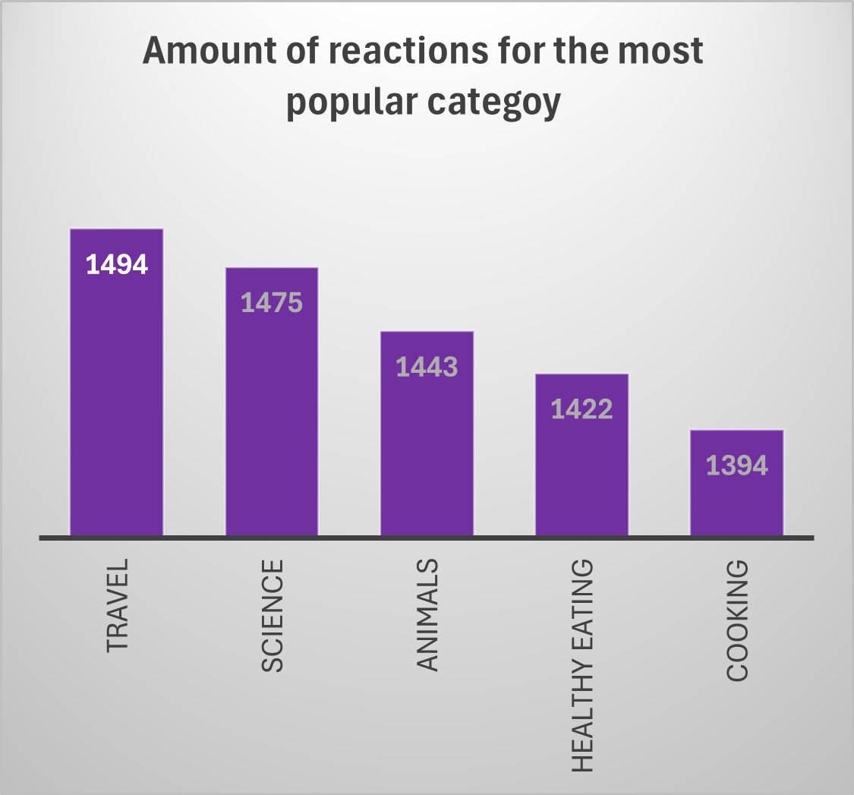
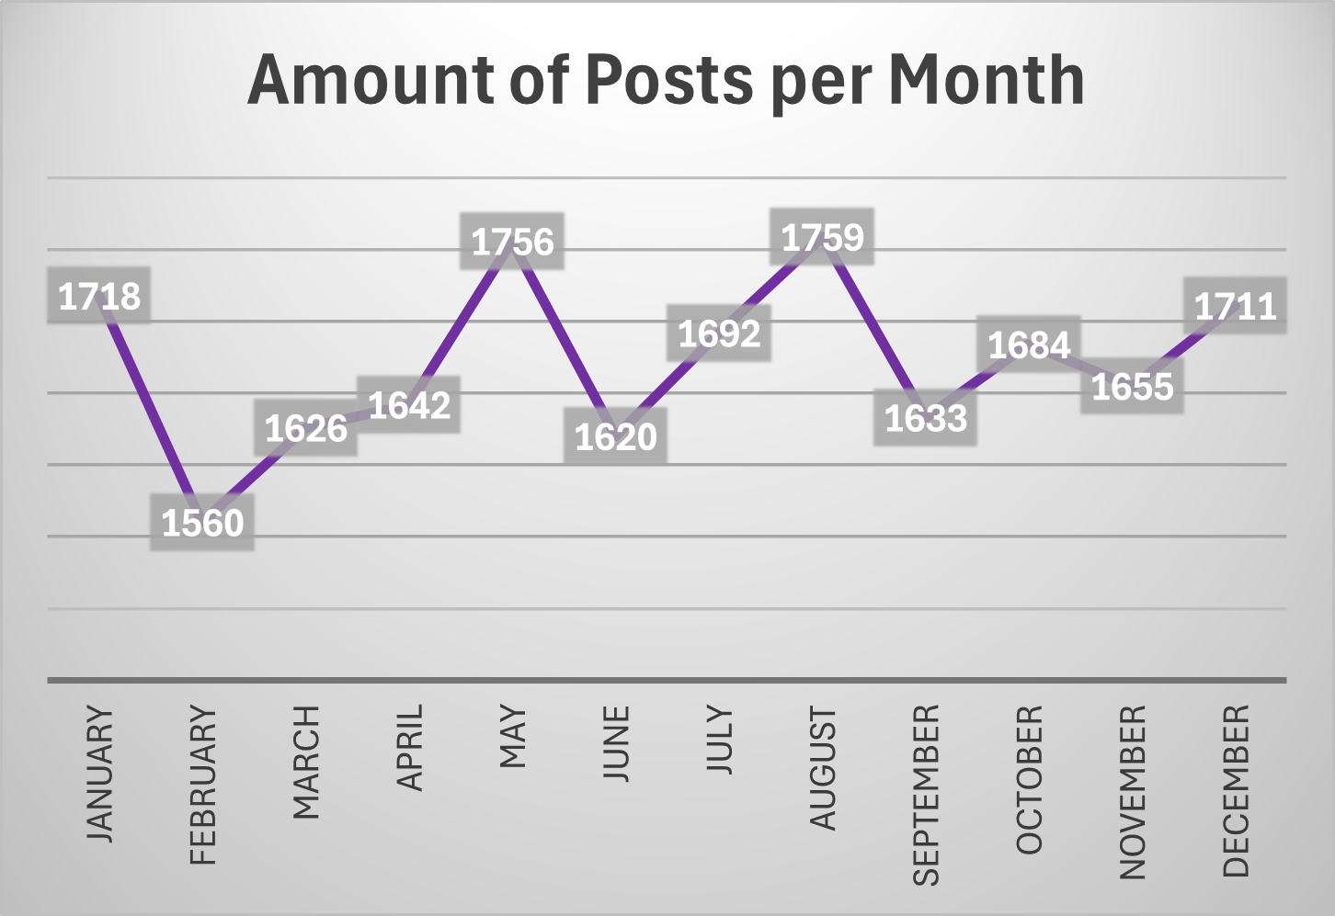

Slide 10

From the previous analysis we found out that:
The top 5 most popular categories on the Social Buzz platform are:
Travel
Science
Healthy Eating
Animals
Cooking
in that order.
Travel is the most popular category with 1494 reactions, followed by Science and Healthy Eating. This could mean that people is keen on a healthy diets while also interested in travelling and it seems that they want to keep up to date with science news.
Working with brands that promote healthy products or travel packages might be a good idea.
Also, in May and August are the best time to do advertising because there is a lot of activity during those months.
Summary

Slide 11
Thank you!
ANY QUESTIONS?

